Slide 1
Crypto-Currencies – Feb 22
Agenda
Warm-Up Quiz
Case C.1 Crypto-Currencies
Begin Level 3 today
Complete levels 1, 2, and 3 asap
NOTE: Re-Download Case C.1 for latest version!!!
Upcoming
t.b.d.

Slide 2
Warm-Up Quiz
Consider the following code:
numberValue = 3
if (numberValue <= 2) :
print("A small number")
elif (numberValue >= 3) and (numberValue <= 6) :
print("A medium number")
else :
print("A large number")
Predict the result of the above code.
What range of numbers are considered “large”?
What range of numbers are considered “small”?

Slide 3
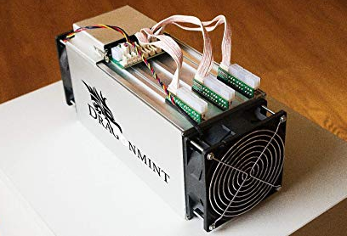
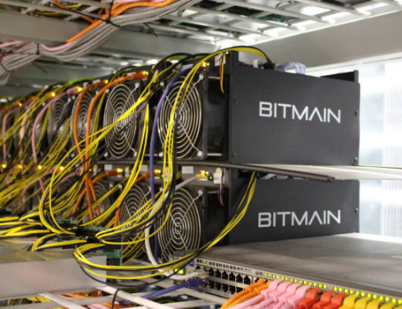
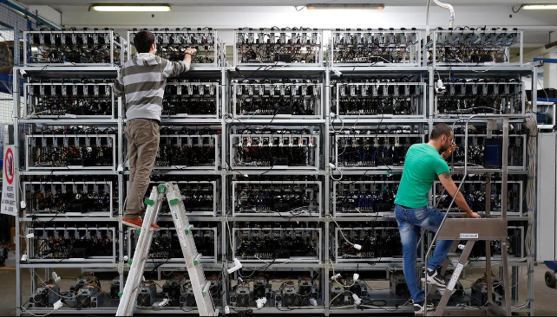
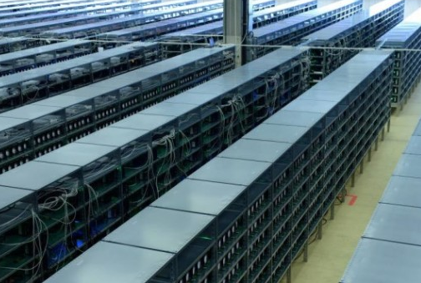
BitCoin Mining

